Slide 1
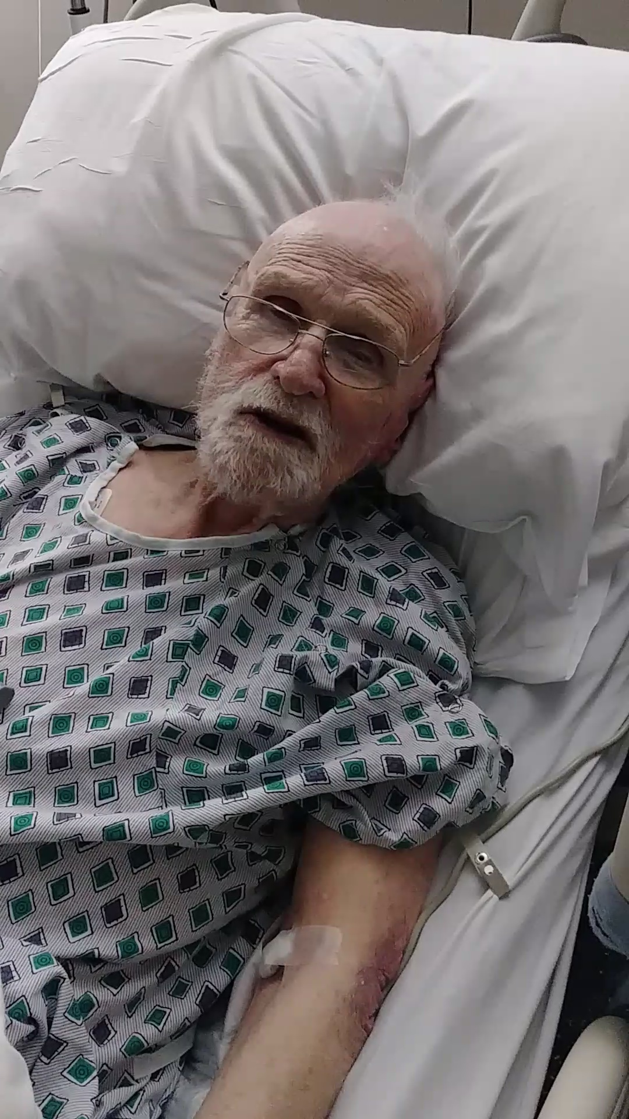
Welcome
the Identity Project
Notes:
I.P. ~FANCY → ~Big Show, ~Choir / ~Big Wig Speakers
Just ME = Keith McC → 100 Yrs Old → j.k. My **DAD is!!
This Wk: Arguing w/ Dad = Hospital → **MOVIE
Knee Probs = CANE!!!
?? DO Here ?? → Rewire Ur Brain → I.P.=Ident. Crisis??

Slide 2


Why Go to a Bible Study?
D U M B
Notes:
Answ. #1 Quest → on Sat. PM? (=1 Hr)
Better Yet: ** ?? DUMB ?? =Most Ppl.
AP: IP-ers → Underst. & Answ.

Slide 3
Why Go to a Bible Study?
R a d i c a l
Notes:
RADICAL=“Mind-Blowing” b/c G=Cares About U!!

Slide 4

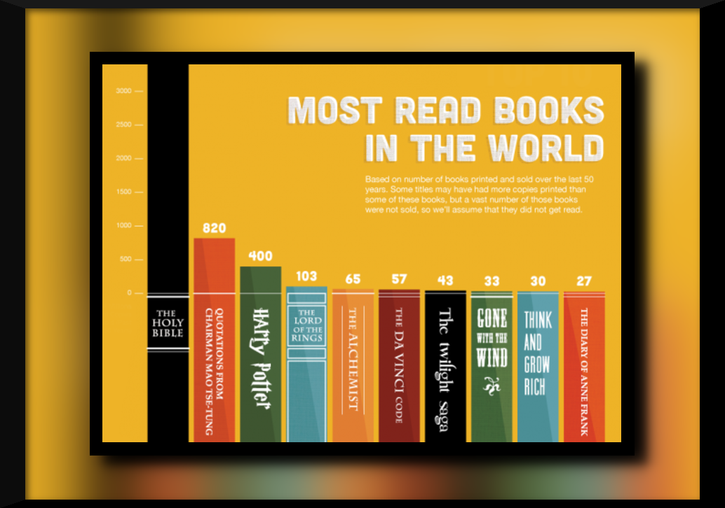
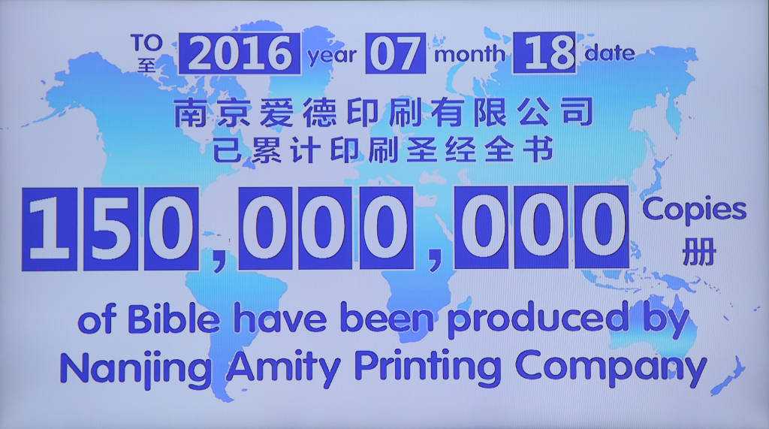
Why Go to a Bible Study?
“Extremely Dumb”
“Extremely Radical”
In the past 50 years
Printed & Sold
(Source: Wycliffe Translators)
#1 The Bible is Boring
The Bible is the #1 best-seller of all time. Every year.
Notes:
** Dumb v. Radical… ** BOOOORING
** Best-Seller = REASON!?!
?? All the Excitement About ??
** Printed / SOLD → ~Incl. GIVEN AWAY
** Nanjing=?? ** 90% Own → Avg=3
Why r All These Bibles Sitting Around Everywhere?

Slide 5

Why Go to a Bible Study?
“Extremely Dumb”
“Extremely Radical”
#1 The Bible is Boring
The Bible is the #1 best-seller of all time. Every year.
Love isn’t boring!
1 John 4:8
Notes:
Love ~Boring = Why they call me Dr. Love
** 1Jn. 4:8 → Bible = G’s Love Letter 2 Humankind
i.e., God = GROVELLING 2 Get R Attention

Slide 6
Why Go to a Bible Study?
“Extremely Dumb”
“Extremely Radical”
Profound Unity
66 books, 30+ authors
Different backgrounds
1 Story
Ain’t never seen one.
Apparent contradictions = look more closely.
Why did so many brilliant scholars miss that?
#2 The Bible is full of contradictions
Notes:
Contradictions = USELESS 2 Study…Jibberish
** ~Seen 1 → WHERE?
** Luk Closely→ CAN Find 1 If U Want 2
** Scholars = 10s of 1000s
** = Profound UNITY → Points 2 JC

Slide 7
Why Go to a Bible Study?
“Extremely Dumb”
“Extremely Radical”
John 3:16-17 ¹⁶ “For God loved the world so much that he gave his one and only Son, so that everyone who believes in him will not perish but have eternal life. ¹⁷ God sent his Son into the world not to judge the world, but to save the world through him.
True, if you want to.
Why not let God speak for Himself?
#3 You can make it say whatever you want.
Notes:
** True → ?? Want 2 ??
IL: Blacks=Cursed, SLAVES / KILL 4 CHRIST = Temp!!
Xianity=OUTLAWED Slavery → ~1 Kills 4 JC 2Day
AP: U *Can* BUT → ~WORK
**G=Speak 4 Himself=UNIQUE Aspect of Bible
?? G. Say ?? → **Jn.3:16 → ?? U Want That 2 Mean ??
Xianity Agrees
IL: Fights = “He ~LISTEN 2 Me!!” =BAD!! → Why Bible?

Slide 8
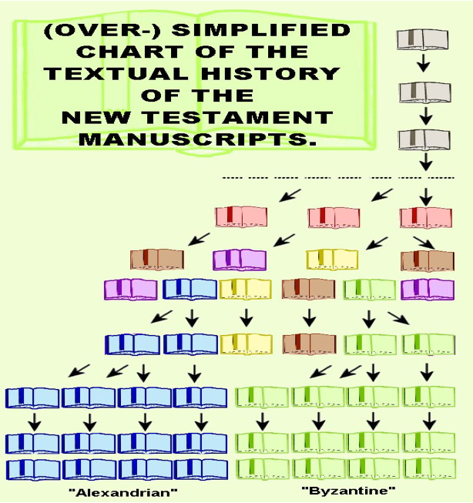
Why Go to a Bible Study?
“Extremely Dumb”
“Extremely Radical”
#4 It’s been copied too many times… nobody knows what the original was.
Fortunately, there’s LOTS of obsessive-compulsive control freaks in the world!
Over 25,000 Ancient MSS
Notes:
** Fortunate→Most=In Seminaries (IL: Bruce)
** Family Trees ** 25K → ~ An Issue!!
<5% Disagree → sso M;;an;y Denomin. = GUD
(Pope ~ Like It)

Slide 9
Why Go to a Bible Study?
“Extremely Dumb”
“Extremely Radical”
More than a few scientists & historians would disagree!
NOTE: the Bible doesn’t say the earth is 6,000 years old or anything like that!
#5 It contradicts science & history, full of legends & myths!
Notes:
** …Disagree→ Roadmap 4 Archeologists
Dr. Morscher / Baker / Smith / &Dr. LUV
~Contradict Scientific/Historical FACTS
** ~6k = Most Popular SLANDER = Kentucky!!

Slide 10
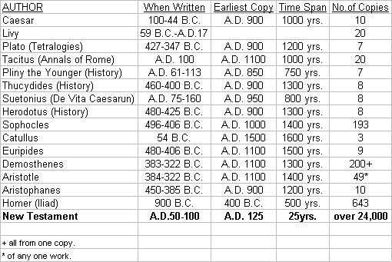
Why Go to a Bible Study?
“Extremely Dumb”
“Extremely Radical”
How do you trick whole populations into accepting forged documents (without a fuss)?
#6 Written LONG after the events!
Notes:
** w/o a Fuss? → DIVISIONS!!
Ppl ~LIKE RELIGIOUS SURPRISES
IL: “a NEW Koran!!”
Skeptics = 90% of Bible=Late Forgeries!!
**

Slide 11
Why Go to a Bible Study?
“Extremely Dumb”
“Extremely Radical”
Ephesians 1:1
Paul, an apostle of Christ Jesus by the will of God, To the saints who are at Ephesus and who are faithful in Christ Jesus:
#7 It’s too complicated for “normal” people to understand.
Thank-you!
NOT to complicated for slaves, peasants and children, however.
Notes:
Normal→ Only XPERTS Can Undrst.
**Thanks = I’m a SCHOLAR! → Middle-Ages Rap
** Slaves/Peasants/Children=Orig. Audiences
IL: In Israel, kids = MEMORIZE Pentateuch
** IL: “2 ALL the SAINTS…”

Slide 12

Jabs, Stabs, Jabber
BART
Boring!
Full of Contradictions
Too Complicated
Says whatever you want
Myths, legends, unscientific
Unknown original text
Notes:
JABBER = ** Irrational Contradictions, ~COHERENT
JABS/STABS → ~Difficult 2 Dismiss → ~Thought-Out
BORING? → Best way to start Saturday
ASK: ??Bother Discrediting a Discredited Book?
IL: **Bart (=Jolly) → How Many Work @ Discredit. Homer?

Slide 13

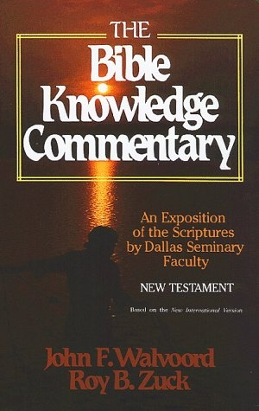
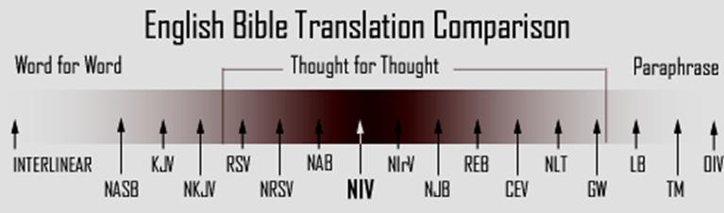
How to Study the Bible?
Get a Good Translation
READ it!
Study what you don’t understand
ASK QUESTIONS!!
Notes:
Translations → ESV=NASB → KJV= “Divers Temptations”
= HUGE Committees → 70 Scholars Agreeing
SO MANY TRANSLATIONS = GOOD
READ = PERSONAL Love Letter → ASK G.
STUDY = Fascinating / In-Depth
Quest = @CT, HC, CG → Ppl LOVE it
I ~ Grand Wizard -→ Just a bad habit

Slide 14
Follow Us:
Twitter: @neoxenos
Facebook: Join the NeoXenos Group

Slide 15
Why “Identity Project” ?
Paul’s Letter to the Romans (7:6)
Now we have been released from the law, for we died to it and are no longer captive to its power.
Now we can serve God, not in the old way of obeying the letter of the law, but in the new way of living in the Spirit.
“RELEASED”
from religious rules / rituals
“DEAD”
to institutional religion
NOT CAPTIVE
means FREEDOM
Notes:
?? Called I.P.?? = ** ROMANS=Ur IDENTITY=Everyth!!
IL: **7:6a = **RELEASED / **DIED / **~CAPTIVE
FREEDOM = God’s Work on Earth → Freedom Wars

Slide 16
Why “Identity Project” ?
Paul’s Letter to the Romans (7:6)
Now we can serve God, not in the old way of obeying the letter of the law, but in the new way of living in the Spirit.
Why “serve God” ?
Notes:
“OLD” = “OBEY” = RULES / “Get in line!”
“NEW…Way” = NEW LIFE = Relat. w/God
?? Serve G ?? → =Freedom!?!

